Slide 1

Problem Statement and Team Details
Problem Statement: Smart Doc Checker is an AI tool that scans multiple documents, detects contradictions or conflicts, and provides clear reports to avoid confusion and errors.​
Team Name: DREAMERS​
Team Leader Name: T. SAI JASHAN​
Institute Name: KLH Hyderabad​
Team Leader Email ID: 2420080045@klh.edu.in​

Slide 2
Problem and Solution
Problem Statement
Organizations maintain multiple documents (rules, policies, contracts).​
These often conflict (e.g., 10 PM vs midnight deadlines, 75% vs 65% attendance).​
Manual checking is time-consuming, boring, and error-prone, leading to confusion and mistakes.
Solution​
Smart Doc Checker – an AI-powered tool that:​
Let's users upload multiple documents.​
Scans and highlights contradictions automatically.​
Generates a clear report with issues and suggestions.​
Saves time, reduces errors, and ensures consistency.​
​

Slide 3
Methodology & Implementation
Document Upload → Upload 2–3 files (PDF, Word, Text) via drag-and-drop.
Text Extraction → Extract text using PyPDF2 (PDF), python-docx (Word), or plain text reading.
Preprocessing → Clean, normalize, and split text into sentences/rules.
Contradiction Detection → Compare rules, detect mismatches, and highlight conflicts with AI/NLP.
Report Generation → Summarize conflicts and provide downloadable PDF/Word reports.
Integration & Monitoring → Track usage and auto-check updates (Pathway).
Frontend Display → Show files, conflicts, and reports in a user-friendly interface. Automation & Efficiency → Streamlines document comparison & reduces manual checking time.

Slide 4
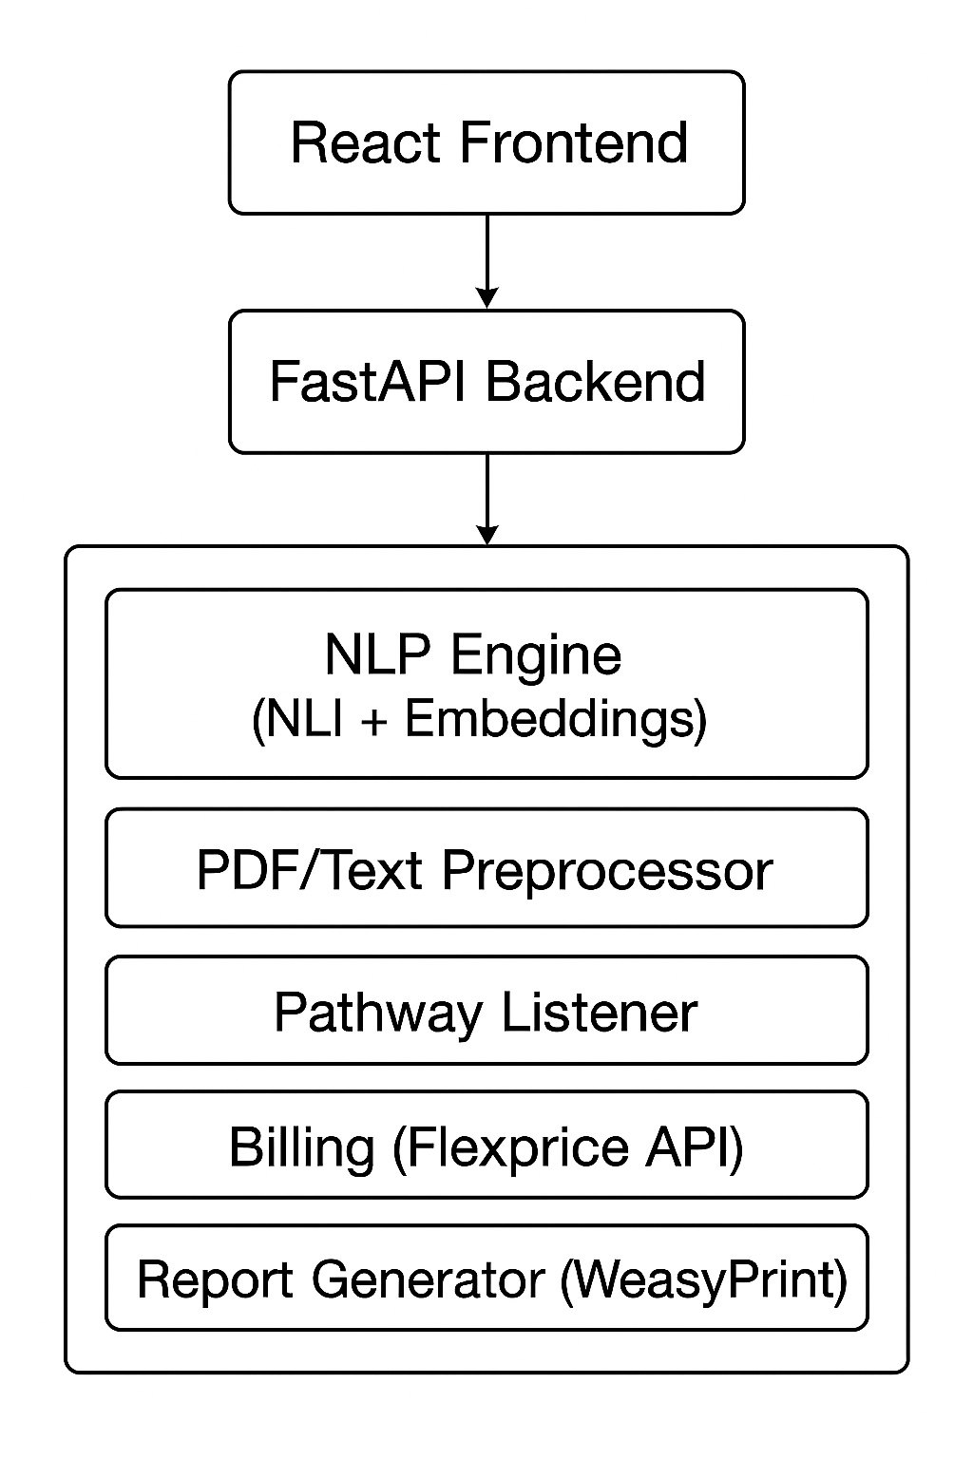
Methodology & Implementation
React Frontend → User uploads docs & sees results. FastAPI Backend → Handles requests and connects frontend to backend services
PDF/Text Preprocessor → Extracts and cleans text from files NLP Engine (NLI + Embeddings) → Detects contradictions and similarities Pathway Listener → Controls workflow steps
Billing (Flexprice API) → Tracks usage and costs

Slide 5
Technology Used
Programming Languages: JavaScript
Libraries & Frameworks:
PyPDF2 → PDF extraction
python-docx → Word extraction
Backend: Flask/Django (Python) for server-side processing
Database (if needed): SQLite/PostgreSQL for storing reports or user data
Integration Tools: Flexprice → Usage tracking, Pathway → Policy monitoring
Frontend: HTML, CSS, JavaScript (or any web framework like React)
Report Generation: PDF/Word generation libraries (FPDF, python-docx)

Slide 6
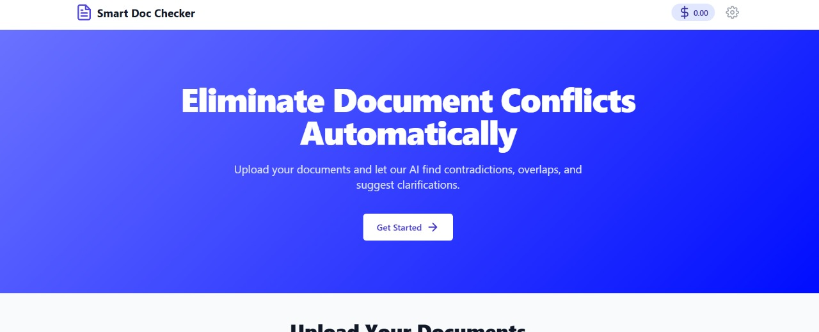
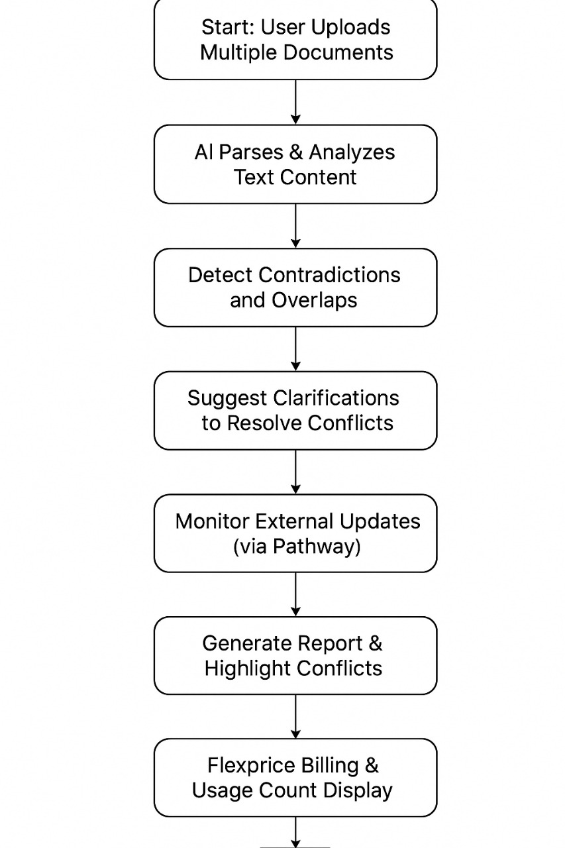
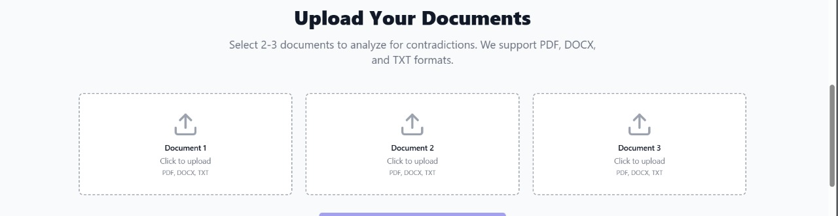
SUPPORTING IMAGES
Flowchart & Supporting Images
FLOWCHART

Slide 7
Feasibility and Market Use
Technical Feasibility: The system can be implemented using widely available Python libraries such as PyPDF2 (for PDF extraction), python-docx (for Word files), and NLP tools (like spaCy or NLTK) for text processing and contradiction detection.
Operational Feasibility: Easy for users to upload documents, get reports quickly, and monitor updates automatically.
Market Use: Useful for HR, legal, compliance, and policy management teams to quickly detect contradictions, reduce manual checking, and ensure consistent rules across documents. The tool can be scaled across departments or organizations, making it a practical solution for various industries.

Slide 8
Conclusion
The Smart Doc Checker is a robust and scalable AI-driven solution that addresses a common pain point—detecting contradictions across multiple documents.
By automating this process, it saves time, reduces human error, and minimizes the risk of disputes or compliance failures. Pathway’s live update feature allows continuous monitoring of policy changes or external documents, ensuring that users are always working with the most current and accurate information.
Its versatility makes it market-ready for industries such as education, HR, legal, startups, and government sectors, positioning it as a valuable compliance and productivity tool.

Slide 9
REPOSITORY LINK
GitHub Repository link : https://github.com/SAIJASHAN/DREAMERS-KLH-BCH.git

